Slide 1


SEARCH ENGINE IN RACLE
Presented by Nguyễn Minh Công - Nguyễn Đình Hùng

Slide 2

Our Presentation
Outline
About Oracle Database
Search Engine
Oracle Text
Making Queries To Search Engines From SQL In Oracle Database
Oracle Secure Enterprise Search
The Minion Search Engine

Slide 3

About Oracle Database
Oracle Corporation
Oracle Corporation is an American multinational computer technology corporation headquartered in Redwood Shores, California. The company specializes primarily in developing and marketing database software and technology, cloud engineered systems, and enterprise software products — particularly its own brands of database management systems.
Oracle Database
Oracle Database (commonly referred to as Oracle RDBMS or simply as Oracle) is a multi-model database management system produced and marketed by Oracle Corporation.
It is a database commonly used for running online transaction processing (OLTP), data warehousing (DW) and mixed (OLTP & DW) database workloads. The latest generation, Oracle Database 18c, is available on-prem, on-Cloud, or in a hybrid-Cloud environment. 18c may also be deployed on Oracle Engineered Systems (e.g. Exadata) on-prem, on Oracle (public) Cloud or (private) Cloud at Customer. At Openworld 2017 in San Francisco, Executive Chairman of the Board and CTO, Larry Ellison announced the next database generation, Oracle Autonomous Database

Slide 4

















About Oracle Database

Slide 5
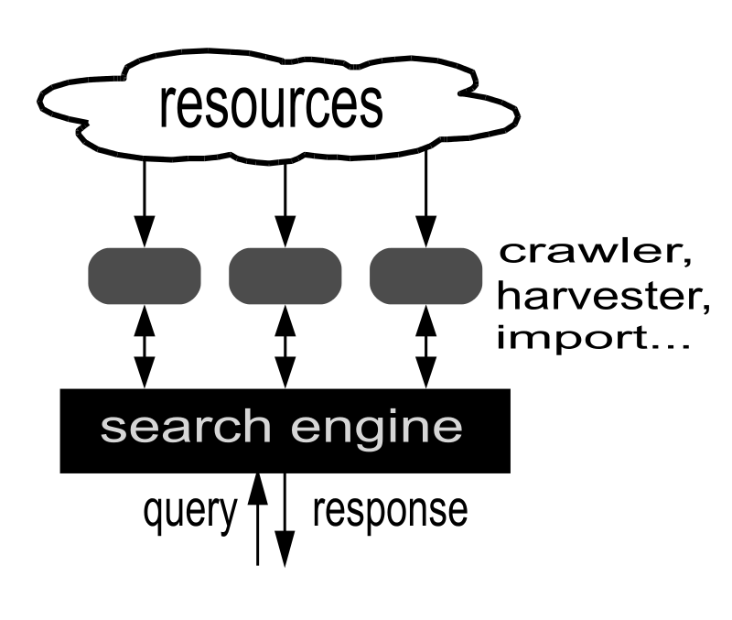
Search Engine
A search engine is an information retrieval system designed to help find information stored on a computer system. The search results are usually presented in a list and are commonly called hits. Search engines help to minimize the time required to find information and the amount of information which must be consulted, akin to other techniques for managing information overload.

Slide 6
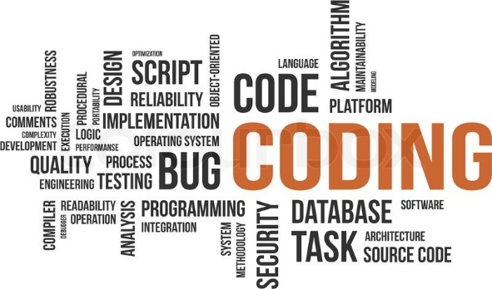
Oracle Text
Introduction to Oracle Text
Oracle Text enables you to build text query applications and document classification applications. Oracle Text provides indexing, word and theme searching, and viewing capabilities for text.
To design an Oracle Text application, first determine the type of queries you expect to run. This enables you to choose the most suitable index for the task.

Slide 7
Oracle Text
Three categories of applications for Oracle Text
Document Collection Applications
A text query application enables users to search document collections, such as Web sites, digital libraries, or document warehouses. The collection is typically static with no significant change in content after the initial indexing run. Documents can be of any size and of different formats, such as HTML, PDF, or Microsoft Word. These documents are stored in a document table. Searching is enabled by first indexing the document collection.
Catalog Information Applications
Catalog information consists of inventory type information, such as that of an online book store or auction site. The stored information consists of text information, such as book titles, and related structured information, such as price. The information is usually updated regularly to keep the online catalog up to date with the inventory.
Document Classification Applications
In a document classification application, an incoming stream or a set of documents is compared to a pre-defined set of rules. When a document matches one or more rules, the application performs some action.

Slide 8
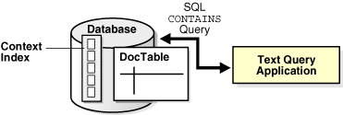
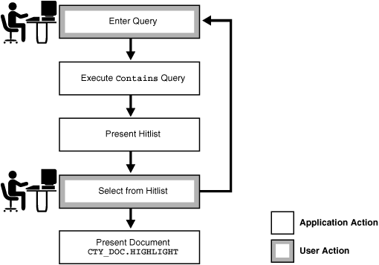
Document Collection Applications
An important factor for this type of application is retrieving documents relevant to a query while retrieving as few non-relevant documents as possible. The most relevant documents must be ranked high in the result list.
Flowchart of Text Query Application
A typical text query application on a document collection enables the user to enter a query. The application enters a CONTAINS query and returns a list, called a hit list, of documents that satisfy the query. The results are usually ranked by relevance. The application enables the user to view one or more documents in the hit list
For example, an application might index URLs (HTML files) on the World Wide Web and provide query capabilities across the set of indexed URLs. Hit lists returned by the query application are composed of URLs that the user can visit.

Slide 9
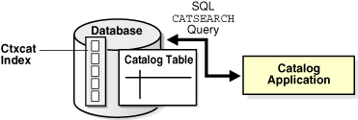
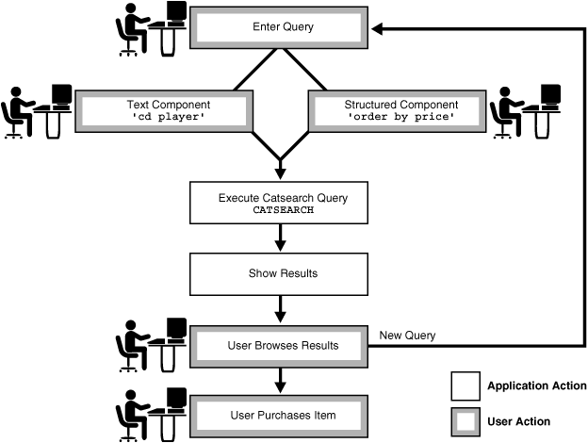
Catalog Information Applications
Queries are usually a combination of a text component and a structured component. Results are almost always sorted by a structured component, such as date or price. Good response time is always an important factor with this type of query application.
Flowchart of Text Query Application
A catalog application enables users to search for specific items in catalogs. For example, an online store application enables users to search for and purchase items in inventory. Typically, the user query consists of a text component that searches across the textual descriptions plus some other ordering criteria, such as price or date.

Slide 10
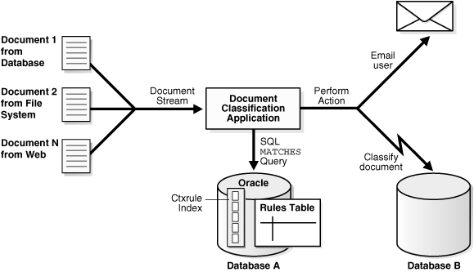
Document Classification Applications
For example, assume there is an incoming stream of news articles. You can define a rule to represent the category of Finance. The rule is essentially one or more queries that select document about the subject of Finance. The rule might have the form 'stocks or bonds or earnings'.
When a document arrives about a Wall Street earnings forecast and satisfies the rules for this category, the application takes an action, such as tagging the document as Finance or e-mailing one or more users.

Slide 11
XML Search Applications (extend)
An XML search application performs searches over XML documents. A regular document search usually searches across a set of documents to return documents that satisfy a text predicate; an XML search often uses the structure of the XML document to restrict the search. Typically, only that part of the document that satisfies the search is returned. For example, instead of finding all purchase orders that contain the word electric, the user might need only purchase orders in which the comment field contains electric.
Oracle Text enables you to perform XML searching using the following approaches:
Using Oracle Text
Using the Oracle XML DB Framework
Combining Oracle Text features with Oracle XML DB

Slide 12
XML Search Applications (extend)
Using Oracle Text
The CONTAINS operator is well suited to structured searching, enabling you to perform restrictive searches with the WITHIN, HASPATH, and INPATH operators. If you use a CONTEXT index, then you can also benefit from the following characteristics of Oracle Text searches:
Searches are token-based, whitespace-normalized
Hitlists are ranked by relevance
Case-sensitive searching
Section searching
Linguistic features such as stemming and fuzzy searching
Performance-optimized queries for large document sets

Slide 13
XML Search Applications (extend)
Using the Oracle XML DB Framework
With Oracle XML DB, you load your XML documents in an XMLType column. XML searching with Oracle XML DB usually consists of an XPATH expression within an existsNode(), extract(), or extractValue() query. This type of search can be characterized as follows:
It is a non-text search with equality and range on dates and numbers.
It is a string search that is character-based, where all characters are treated the same.
It has the ability to leverage the ora:contains() function with a CTXXPATH index to speed up existsNode() queries.
This type of search has the following disadvantages:
It has no special linguistic processing.
It uses exact matching, so there is no notion of relevance.
It can be very slow for some searches, such as wildcarding, as with:
WHERE col1 like '%dog%'

Slide 14
XML Search Applications (extend)
Combining Oracle Text features with Oracle XML DB
Using the Text-on-XML Method
With Oracle Text, you can create a CONTEXT index on a column that contains XML data. The column type can be XMLType, but it can also be any supported type provided you use the correct index preference for XML data.
With the Text-on-XML method, use the standard CONTAINS query and add a structured constraint to limit the scope of a search to a particular section, field, tag, or attribute. This amounts to specifying the structure inside text operators, such as WITHIN, HASPATH, and INPATH.

Slide 15
XML Search Applications (extend)
<?xml version="1.0"?>
<PURCHASEORDER pono="1">
<PNAME>Po_1</PNAME>
<CUSTNAME>John</CUSTNAME>
<SHIPADDR>
<STREET>1033 Main Street</STREET>
<CITY>Sunnyvalue</CITY>
<STATE>CA</STATE>
</SHIPADDR>
<ITEMS>
<ITEM>
<ITEM_NAME> Dell Computer </ITEM_NAME>
<DESC> Pentium 2.0 Ghz 500MB RAM </DESC>
</ITEM>
<ITEM>
<ITEM_NAME> Norelco R100 </ITEM_NAME>
<DESC>Electric Razor </DESC>
</ITEM>
</ITEMS>
</PURCHASEORDER>
Combining Oracle Text features with Oracle XML DB
Using the Text-on-XML Method
To query all purchase orders that contain Pentium within the item description section, use the WITHIN operator:
SELECT id from po_tab where CONTAINS( doc, 'Pentium WITHIN desc') > 0;
Specify more complex criteria with XPATH expressions using the INPATH operator:
SELECT id from po_tab where CONTAINS(doc, 'Pentium INPATH (/purchaseOrder/items/item/desc') > 0;

Slide 16
XML Search Applications (extend)
Combining Oracle Text features with Oracle XML DB
Using the XML-on-Text Method
With the XML-on-Text method, you add text operations to an XML search. This includes using the ora:contains() function in the XPATH expression with existsNode(), extract(), and extractValue() queries. This amounts to including the full-text predicate inside the structure. For example:
SELECT
Extract(doc, '/purchaseOrder//desc{ora:contains(.,"pentium")>0]',
'xmlns:ora=http://xmlns.oracle.com/xdb')
"Item Comment" FROM po_tab_xmltype
Additionally you can improve the performance of existsNode(), extract(), and extractValue() queries using the CTXXPATH Text domain index.

Slide 17
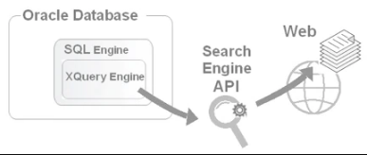
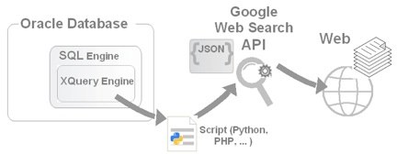
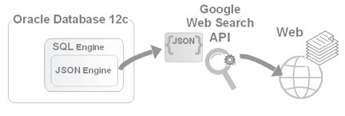
Making Queries To Search Engines From SQL In Oracle Database
Introduction
One of those things that make Oracle Database outstanding is a wide range of options when it comes to accessing and manipulating data of different types – located both inside and outside of the database. This article illustrates Oracle Database’s ability to derive data from the external sources that can dynamically generate datasets upon requests coming from the database, joining then those datasets with relational data, if necessary, of course. In particular, it explains how you might access a search engine’s API from within an Oracle database, obtaining search results programmatically – that is, outside of a browser context.

Slide 18
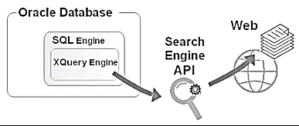
How It Works
Viewing the Web as a huge data container, you can find it similar to a database, in a sense that both can be queried for information of interest.
The key difference lies in the way you write a query.
With the introduction of Oracle XQuery in release 10.2, Oracle Database acquired the ability to query XML-expressible datasets with a URL, shredding the results into relational data if necessary.
Everything that is callable with a URL can be queried with XQuery.
Oracle Database supports XQuery through SQL/XML functions, such as XMLTable and XMLQuery, you can access a search engine’s API from within a SQL query, which makes it possible to combine the search results with the other data the SQL query retrieves.

Slide 19
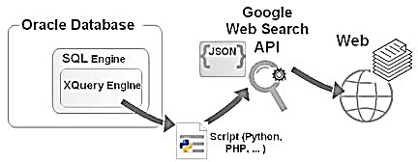
Doing Google Searches From Within an Oracle Database
Although this API has been deprecated as for now, the good news is that it still works and its Developer's Guide is also still available.
To make a request to the Google Web Search API from your code, you have to open the URL for the API with the q URL argument supplying the search expression. For example, if you want to perform a Web search for Oracle XQuery, the URL to open should look like this:
For example, if you want to perform a Web search for Oracle XQuery, the URL to open should look like this:
Prior to Oracle Database 12c, you could not make a request to the Google Web Search API directly from within an XQuery query. The problem was that Oracle Database did not recognize JSON. You had to employ a middleman between XQuery and the API, transforming JSON into XML.
http://ajax.googleapis.com/ajax/serveices/search/web?v=1.0&q=Oracle%20XQuery
You could use a script written in Python or PHP, which would initiate a programmatic Web search and then transform JSON into XML before returning the results to the calling XQuery query.

Slide 20
Doing Google Searches From Within an Oracle Database
Before you can write such a mediator script however, you have to know the structure of the JSON object that represents a result set returned by a Google Web Search API query.
Another simple way to look at the structure of a JSON result set returned is through a browser.
Alternatively, you can obtain this same JSON document through the database by issuing the following query:
Looking through the JSON retrieved, you may notice that it includes a number of key/value pairs describing each search result returned. Suppose you are interested only in the title and URL for each result. In that case, according to the document structure, you might want to extract the values of the titleNoFormatting and url keys.

Slide 21
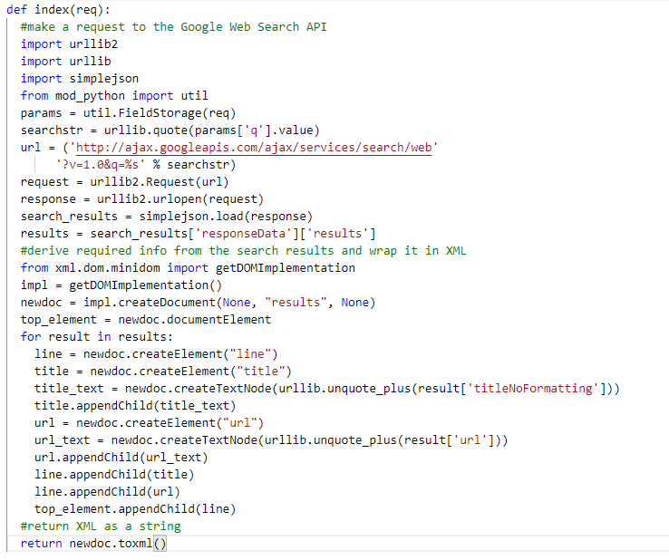
Doing Google Searches From Within an Oracle Database
In Python, the code for the mediator script might look like this:

Slide 22
Doing Google Searches From Within an Oracle Database
Now you might want to test it out from within an Oracle database. So, you might issue the following SQL query in SQL*Plus:
VARIABLE search_url VARCHAR2(200);
BEGIN
:search_url := 'http://localhost/gwsearch.py?q=Oracle%20XQuery';
END; SELECT * FROM
XMLTable(
'for $j in $rslts/results/line
return $j'
PASSING xmlparse (document httpuritype
(:search_url).getCLOB()) as "rslts"
COLUMNS title VARCHAR2(100) PATH 'title',
url VARCHAR2(100) PATH 'url');

Slide 23
Doing Google Searches From Within an Oracle Database
The output should look like this (the actual data may vary, of course, since Google periodically updates the search positions of web pages):
TITLE
-----------------------------------------------------------------------
URL
-----------------------------------------------------------------------
Using XQuery with Oracle XML DB - Oracle Documentation
http://docs.oracle.com/cd/B19306_01/appdev.102/b14259/xdb_xquery.htm
XMLQUERY - Oracle Documentation
http://docs.oracle.com/cd/B19306_01/server.102/b14200/functions224.htm
XQuery and Oracle XML DB - Oracle Documentation
https://docs.oracle.com/database/121/ADXDB/xdb_xquery.htm
Oracle XMLQuery XML Query - PSOUG.org
http://psoug.org/reference/xmlquery.html

Slide 24
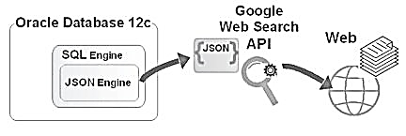
Native Support For JSON In Oracle Database 12c
Now, with Oracle Database 12c understanding JSON natively, you can do without a mediator script like that one you saw in the preceding section, accessing the Google Web Search API directly from within a SQL query
In the following example, you use JSON_TABLE to create a relational view of the JSON data returned by the Google Web Search API:
SELECT * FROM JSON_TABLE{ httpuritype('http://ajax.googleapis.com/ajax/serveices/search/web?v=1.0&q=Oracle%20XQuery').getCLOB(). '$.responseData.results[*]'
COLUMN (title VARCHAR2(100 CHAR) PATH '$.titleNoFormatting',
url VARCHAR2(100 CHAR) PATH '$.url')};
Picking out the data of interest from a JSON output can be done with JSON_TABLE – an Oracle SQL function available in Oracle Database 12c. JSON_TABLE is similar to XMLTable in that it creates a relational view of non-relational data. Just like XMLTable, JSON_TABLE has the COLUMNS clause to define the columns of the relational view to be created

Slide 25
Native Support For JSON In Oracle Database 12c
The output should be the same or similar to the one the XMLTable gave you in the preceding section, provided that the search expression passed to the Google Web Search API remained the same:
Now, with Oracle Database 12c understanding JSON natively, you can do without a mediator script like that one you saw in the preceding section, accessing the Google Web Search API directly from within a SQL query
TITLE
-----------------------------------------------------------------------
URL
-----------------------------------------------------------------------
Using XQuery with Oracle XML DB - Oracle Documentation
http://docs.oracle.com/cd/B19306_01/appdev.102/b14259/xdb_xquery.htm
XMLQUERY - Oracle Documentation
http://docs.oracle.com/cd/B19306_01/server.102/b14200/functions224.htm
XQuery and Oracle XML DB - Oracle Documentation
https://docs.oracle.com/database/121/ADXDB/xdb_xquery.htm
Oracle XMLQuery XML Query - PSOUG.org
http://psoug.org/reference/xmlquery.html
Picking out the data of interest from a JSON output can be done with JSON_TABLE – an Oracle SQL function available in Oracle Database 12c. JSON_TABLE is similar to XMLTable in that it creates a relational view of non-relational data. Just like XMLTable, JSON_TABLE has the COLUMNS clause to define the columns of the relational view to be created

Slide 26
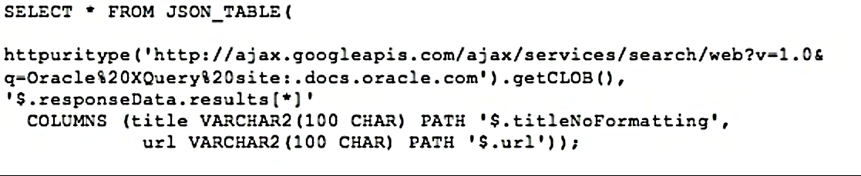
Filtering And Joining
suppose you want to output only those search results for Oracle XQuery that contain substring Oracle Documentation in the title.
To achieve this, you might use the WHERE clause of SELECT like in a regular SQL query issued against relational data:

Slide 27
Filtering And Joining
In the above example, you filter the retrieved search results on the database side. Not surprisingly, the shown result set can be less than the usual result set (4 results by default), since WHERE cuts off irrelevant rows:
TITLE
-----------------------------------------------------------------------
URL
-----------------------------------------------------------------------
Using XQuery with Oracle XML DB - Oracle Documentation
http://docs.oracle.com/cd/B19306_01/appdev.102/b14259/xdb_xquery.htm
XMLQUERY - Oracle Documentation
http://docs.oracle.com/cd/B19306_01/server.102/b14200/functions224.htm
XQuery and Oracle XML DB - Oracle Documentation
https://docs.oracle.com/database/121/ADXDB/xdb_xquery.htm

Slide 28
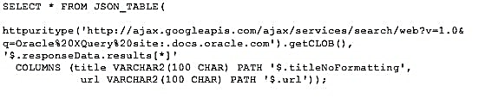
Filtering And Joining
However, if you want to apply filtering and have the maximum number of rows in the result set anyway, you can instruct the searcher to look for results on Oracle XQuery only on the Oracle Documentation website by appending the site: keyword followed by the .docs.oracle.com domain:

Slide 29
Filtering And Joining
This time the output might look like this:
TITLE
-----------------------------------------------------------------------
URL
-----------------------------------------------------------------------
Using XQuery with Oracle XML DB - Oracle Documentation
http://docs.oracle.com/cd/B19306_01/appdev.102/b14259/xdb_xquery.htm
XMLQUERY - Oracle Documentation
http://docs.oracle.com/cd/B19306_01/server.102/b14200/functions224.htm
XQuery and Oracle XML DB - Oracle Documentation
https://docs.oracle.com/database/121/ADXDB/xdb_xquery.htm

Slide 30
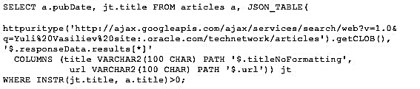
Filtering And Joining
Finally, let’s look at an example of joining search results retrieved by the Google Web Search API with the database data.

Slide 31

Oracle Secure Enterprise Search (SES)
Overview
Oracle Secure Enterprise Search (SES) provides uniform search capabilities over multiple repositories.
Oracle SES uses a crawler to collect data from these sources. The crawler supports a number of built-in source types, as well as a published plug-in (or connector) architecture for adding new types. Multiple Oracle SES instances can also share content through the federated source type.
Oracle SES supports numerous built-in source types: Web, Table, File, E-mail, Mailling list, OracleAS Portal, Oracle Calendar, Oracle Content Database, Oracle Applications, Federated.

Slide 32
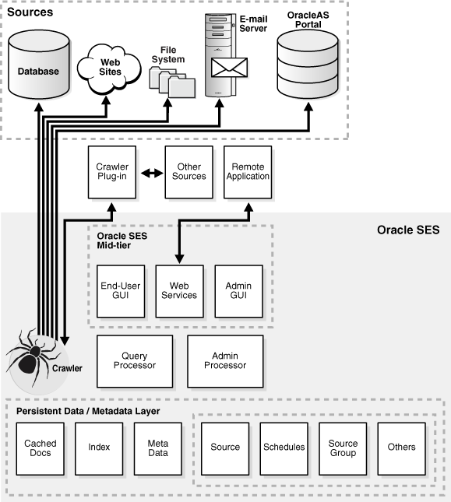
Oracle Secure Enterprise Search Components
Oracle Secure Enterprise Search Crawler
The Oracle SES crawler is a Java process activated by a set schedule. When activated, the crawler spawns a configurable number of processor threads that fetch information from various sources and index the documents. This index is used for searching sources.
The Oracle SES crawler is a Java process activated by a set schedule. When activated, the crawler spawns a configurable number of processor threads that fetch information from various sources and index the documents. This index is used for searching sources.

Slide 33
Oracle Secure Enterprise Search Components
Oracle Secure Enterprise Search Administration Tool
Use the Oracle Secure Enterprise Search administration tool to manage and monitor Oracle SES components. For example:
Define sources and crawling scope
Configure the search application
Monitor crawl progress and search performance

Slide 34
Oracle Secure Enterprise Search Components
Oracle Secure Enterprise Search APIs and Applications
Oracle Secure Enterprise Search provides several APIs. For example, the Crawler Plug-in API enables you to create a custom secure crawler plug-in (or connector) to meet your requirements. With the Web Services API, you can integrate Oracle SES search capabilities into your search application.
Oracle SES also provides an out-of-the-box search application.

Slide 35
Oracle Secure Enterprise Search Features
Information in an enterprise can be spread across Web pages, databases, mail servers or other collaboration software, document repositories, file servers, and desktops. Oracle SES searches all your data through the same interface. Oracle SES is fully globalized and works with 27 languages including Chinese, Japanese, Korean, Arabic, and Hebrew.
This section introduces a few of the features in Oracle SES. It includes the following topics:
Secure Search
Federated Search
Web Services API
Extensible Crawler Plug-in Framework

Slide 36
Oracle Secure Enterprise Search Features
Secure Search
Much of the information within an organization is publicly accessible. Anyone is allowed to view it. Therefore, it is relatively easy for a crawler to find and index that information.
However, there are other sources that are protected. These protected sources might only be viewable by certain users or groups of users. For example, while users can search in their own e-mail folders, they should not be able to search anyone else's e-mail.
For protected sources, the Oracle SES crawler will index documents with the proper access control list. When end users perform a search, only documents that they have privileges to view will be returned.

Slide 37
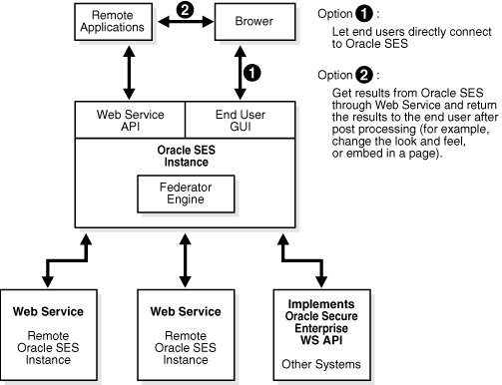
Oracle Secure Enterprise Search Features
Federated Search
Oracle Secure Enterprise Search provides the capability of searching multiple Oracle SES instances with their own document repositories and indexes. It provides a unified framework to search the different document repositories that are crawled, indexed, and maintained separately. A federation broker calls the federation endpoint to collect content matching the search criteria for the sources managed at that endpoint.
Federated search allows a single query to be run across all Oracle SES instances. It aggregates the search results to show one unified result list to the user. User credentials are passed along with the query so that each federation endpoint can authenticate the user against its own document repository.
Create a federated source on the Home - Sources page of the Oracle SES administration tool.

Slide 38
Oracle Secure Enterprise Search Features
Web Services API
Oracle SES offers a Web services API that lets you integrate Oracle SES search capabilities into your search application.
Extensible Crawler Plug-in Framework
Oracle SES provides an extensible crawler plug-in (or connector) framework that lets you crawl and index proprietary document repositories.

Slide 39
End.

Slide 40


Slide 41
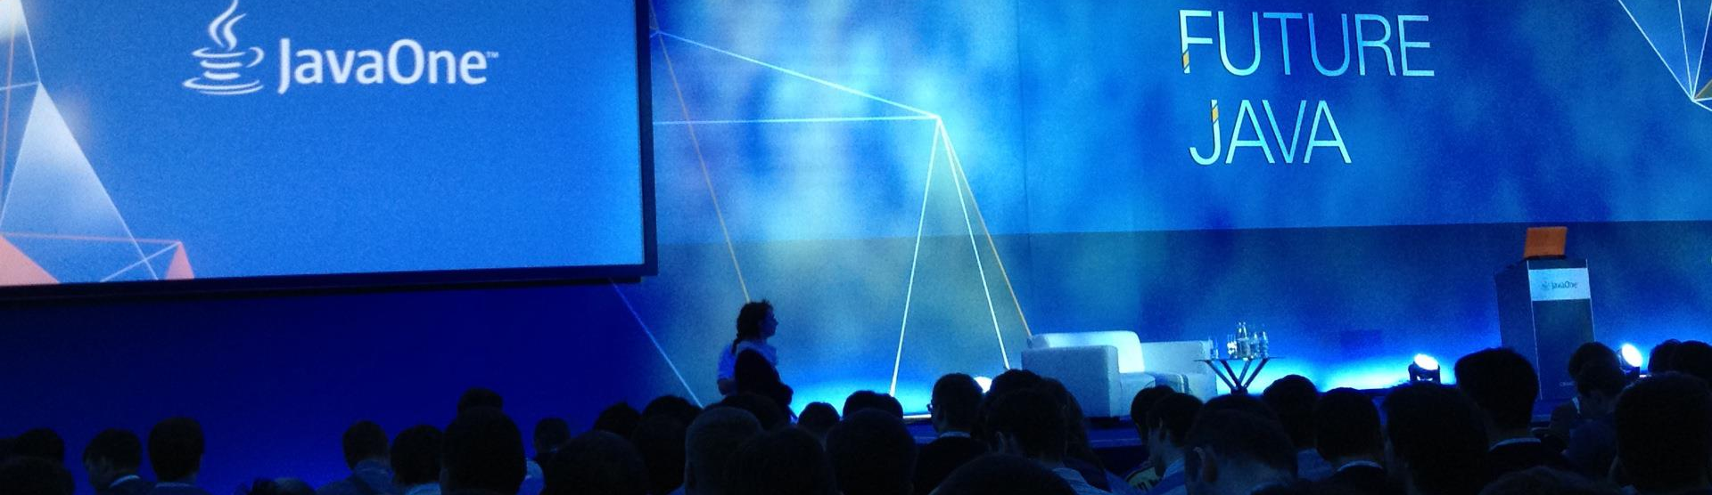
The Minion Search Engine

